Slide 1





FannieSaves.WIN SMU Data Science and Visualization Final Project
Project group
Kip Madden
Scott Whigham
Sean Del Alcazar
Justin Boggs
Joseph McManus

Slide 2



Project Introduction
Motivation: Reflecting on the changes to the economic and interest rate environment as a result of COVID-19, we became interested in the ability of ML to predict economic variables

Slide 3
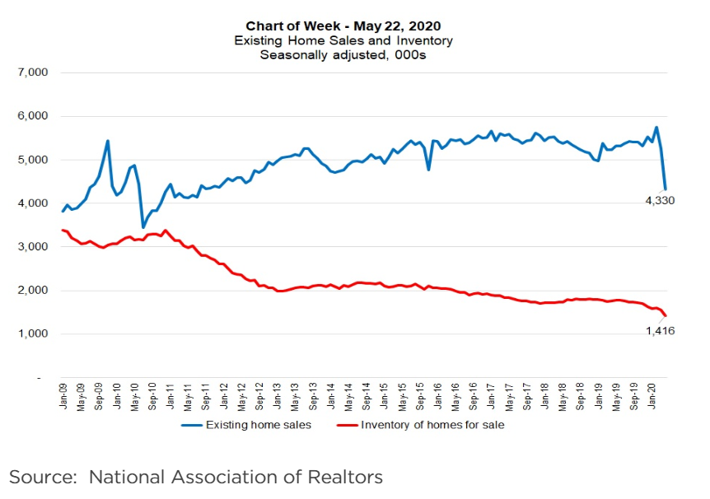
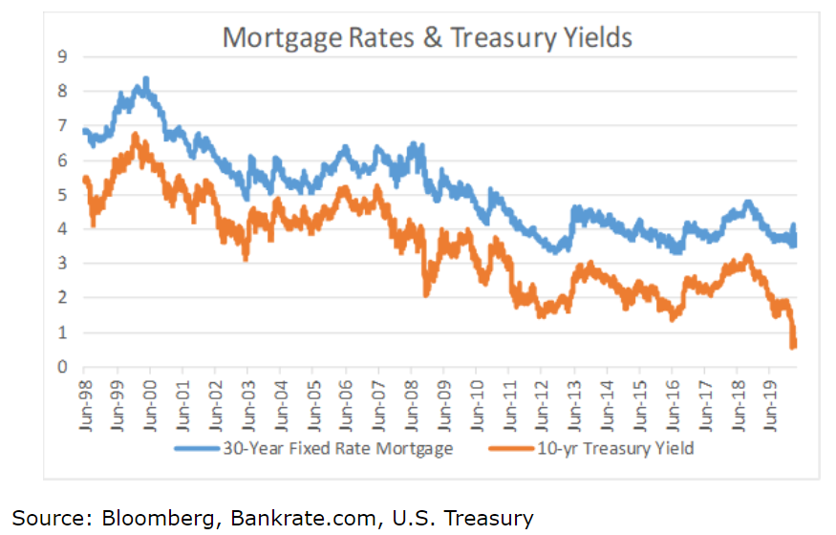
Original Inspiration
Significant changes in the mortgage industry provided inspiration to further explore the power of machine learning for the mortgage industry
(Image as of 4-29-2020)

Slide 4
Project Focus
Primary question: How can machine learning aid Fannie Mae in selecting loans that will perform well?
Final output: FannieSaves.WIN – Our website features an ML-powered application that allows Fannie Mae to supplement their loan purchasing selection:
Fannie Mae can now easily utilize machine learning to determine the quality of an existing loan and its likely future performance

Slide 5














Primary Technologies Employed
Data Gathering | EDA and Data Pre-Processing | ML Model Setup and Building | Web App | Front End Website

Slide 6
EDA and Data Pre-processing
Kip madden

Slide 7
Find the Data
30-year Residential mortgage data from 2000-2019Q1
Freddie Mac 30-yr Mortgage Rates 2000 - Present
10 Year Treasury data 1962 - Present
Confidence data (CCI,BCI,CLI) 2000 - Present

Slide 8


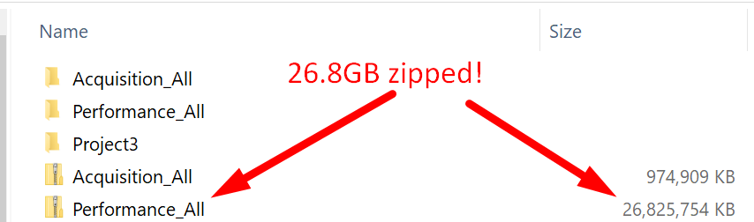

Get the Data
First Challenge was dealing with the size of the data.
Two major files:
Acquisition (one row for each mortgage loan)
Performance (multiple rows for each payment on a loan)

Slide 9
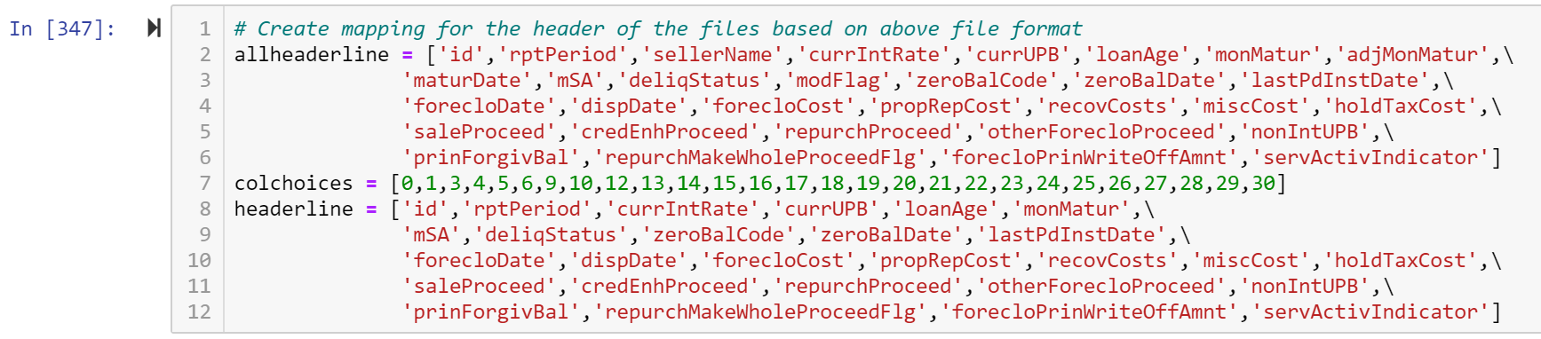
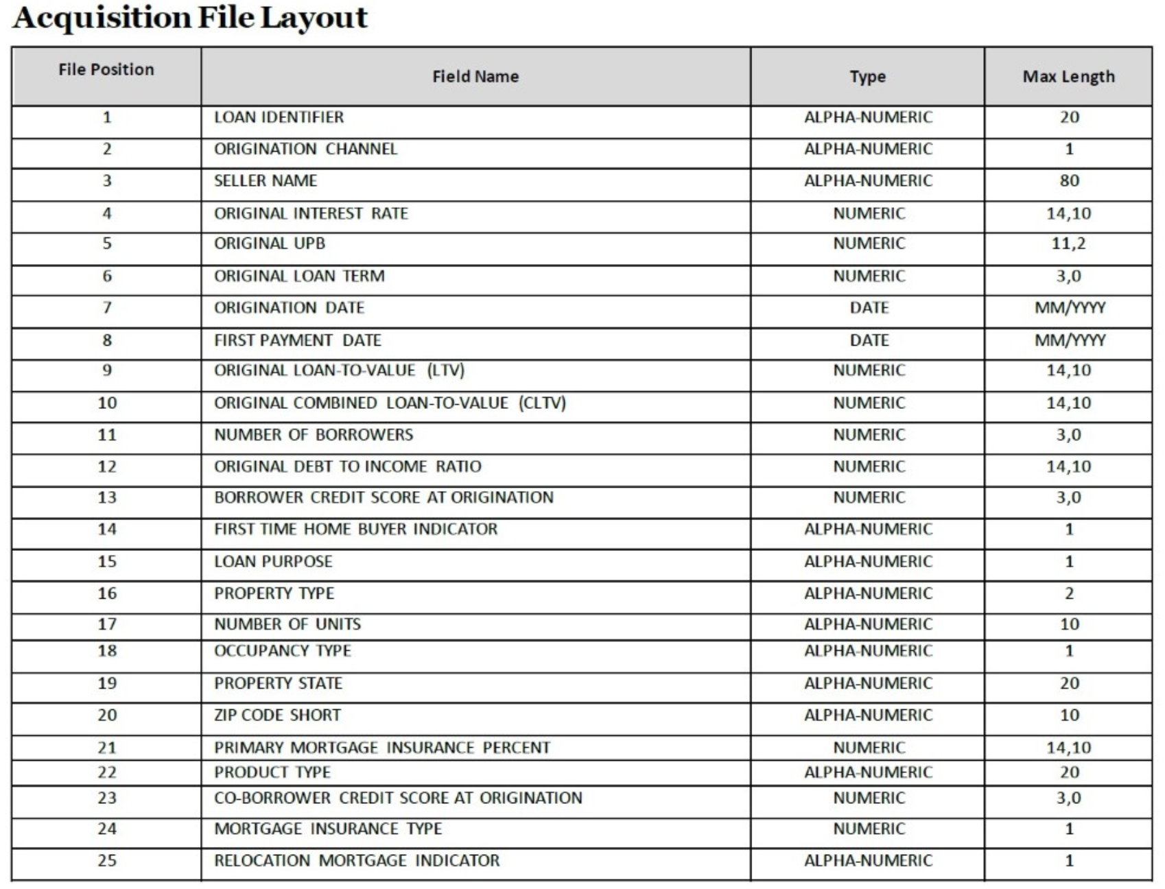
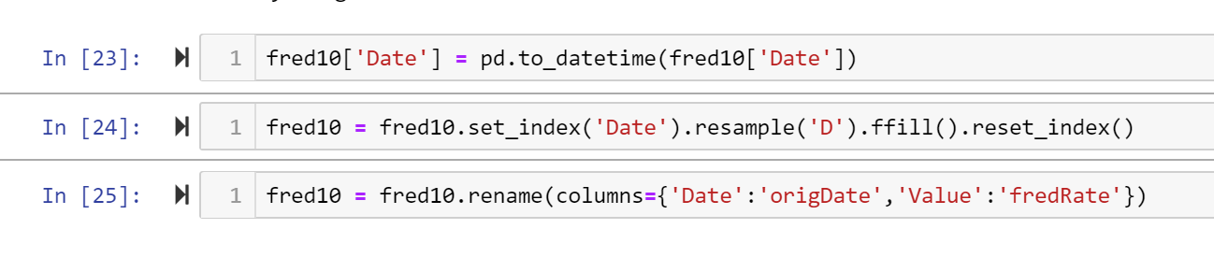
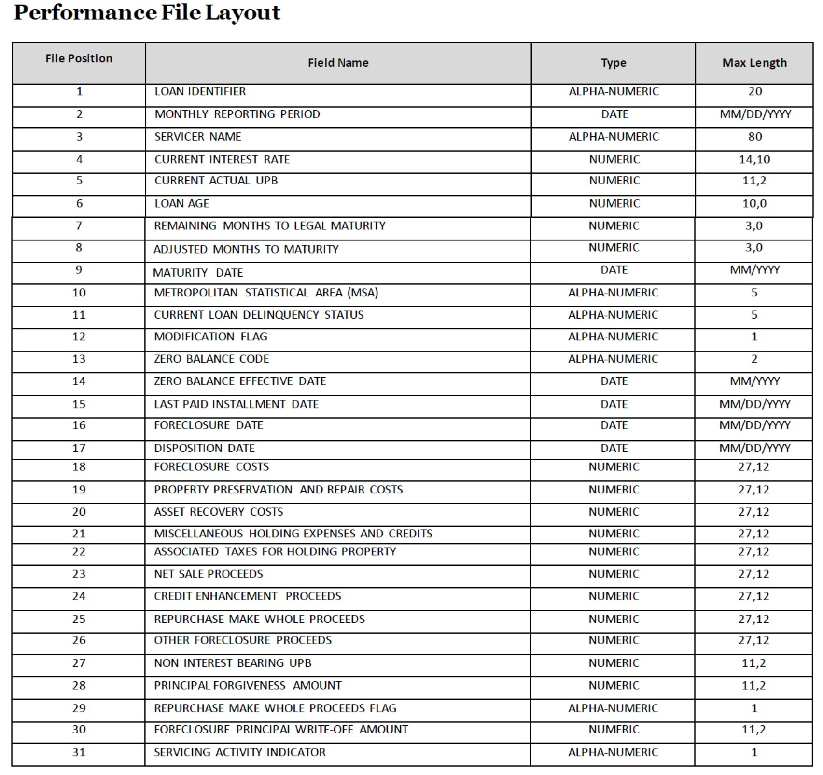
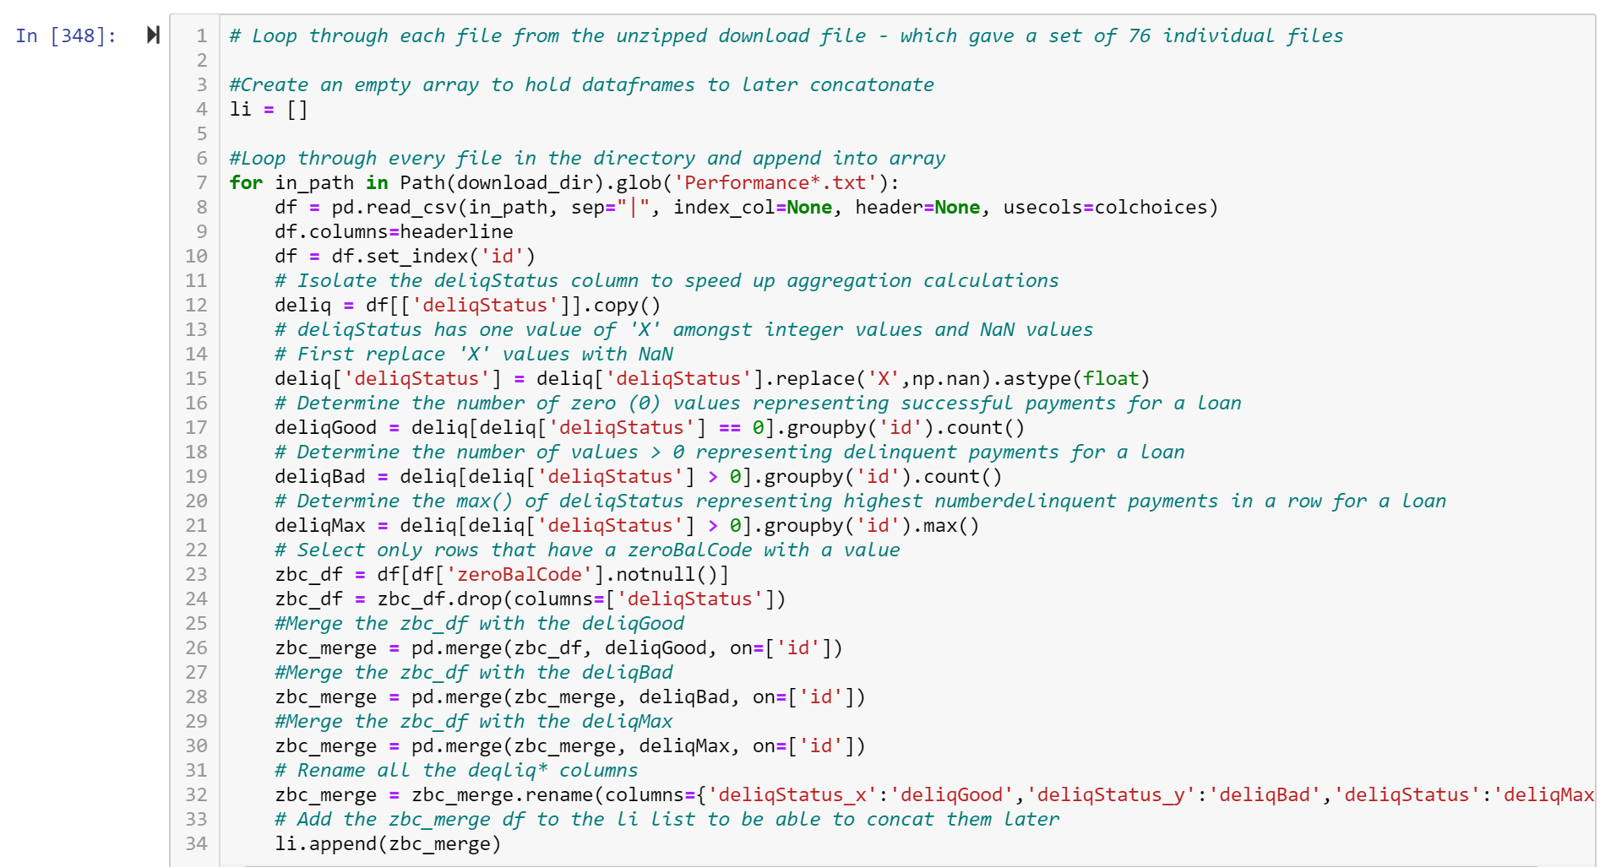
Understanding the Data
Choose columns to keep
Monthly, Weekly, Daily periods resolved
Join on Date issue
Created New Data – “Premium %”
Day of loan origination obfuscated to month
Aggregated loan payment rows to single row
Delinquencies – Max, Count Bad, Count Good

Slide 10
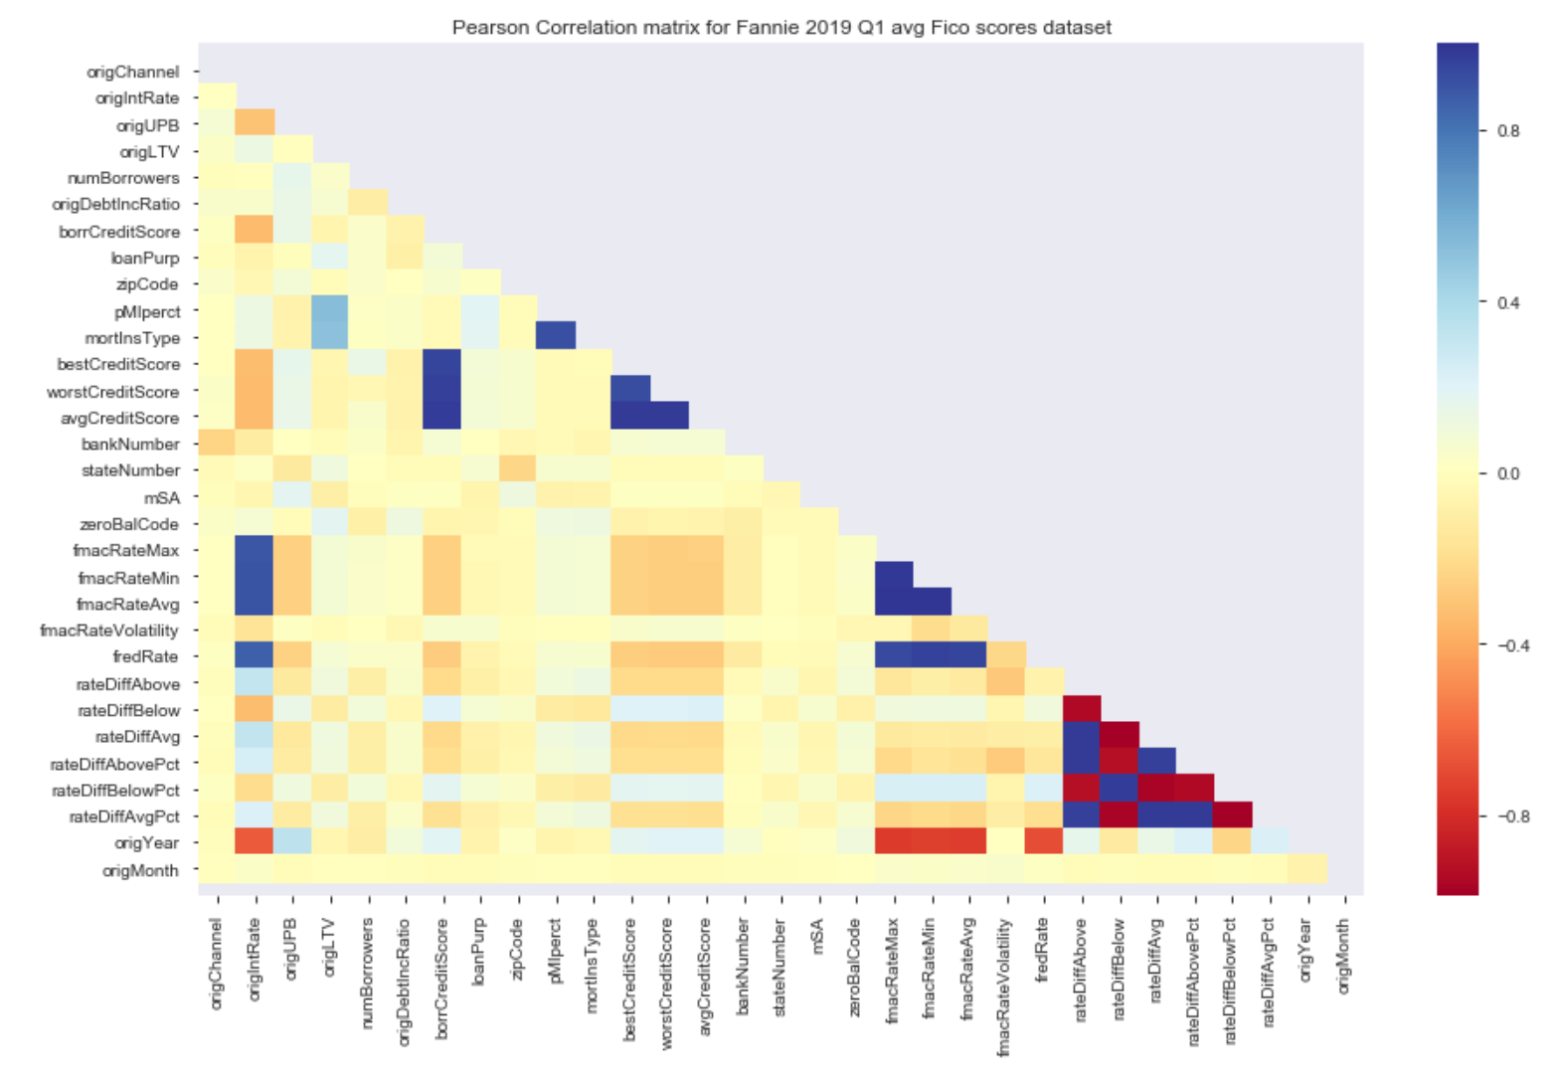
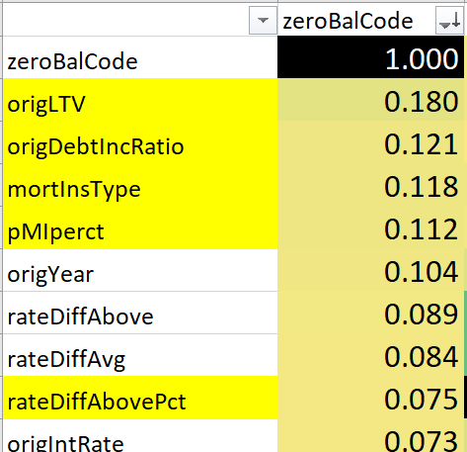
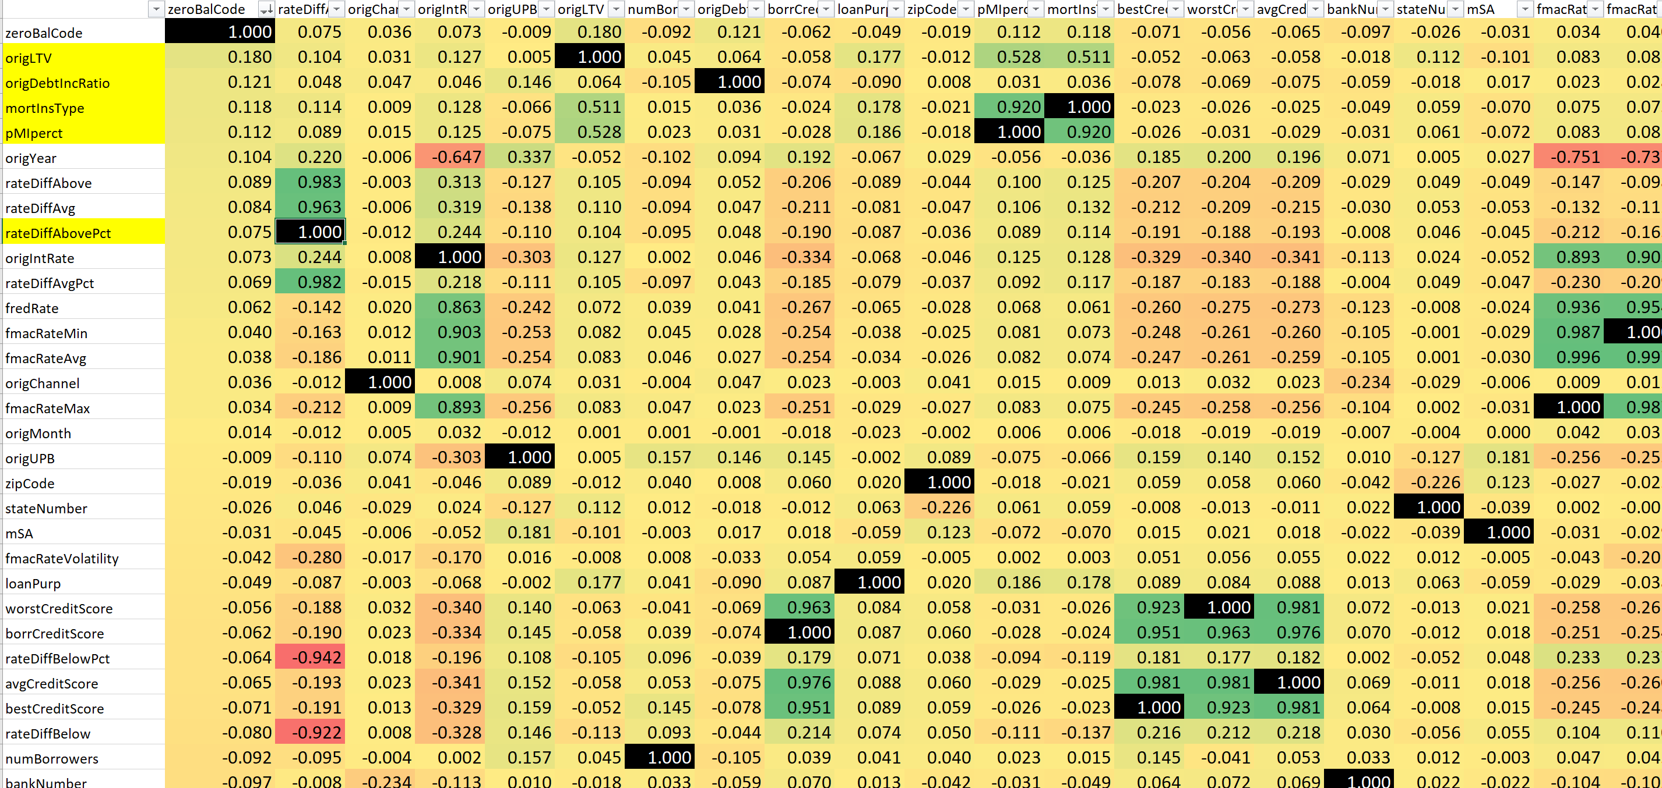
Correlating the Data
LTV (Loan-To-Value)
DTI (Debt-To-Income)
Mortgage Insurance?
Premium %
How much above “Market Rate” did you pay?

Slide 11
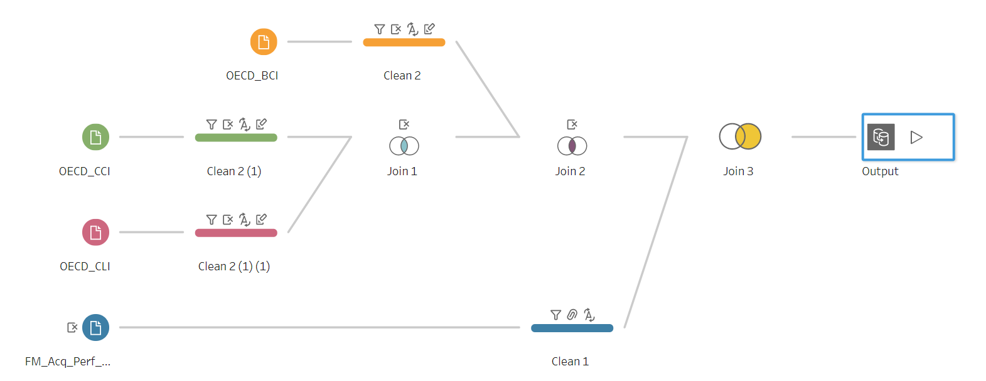
Initial EDA with Tableau Prep Builder

Slide 12
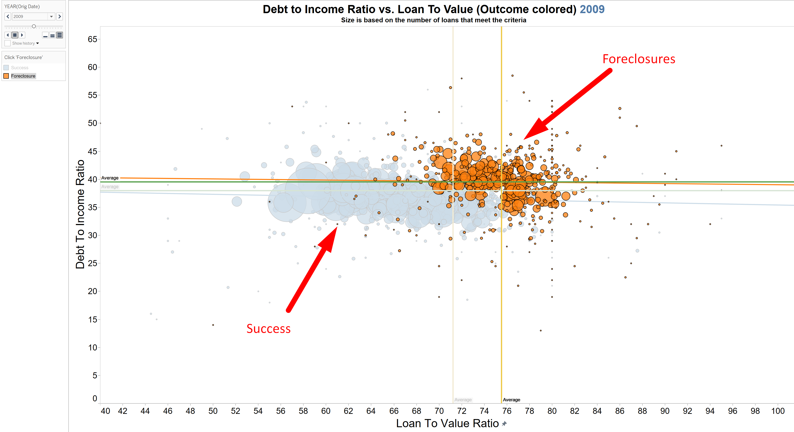
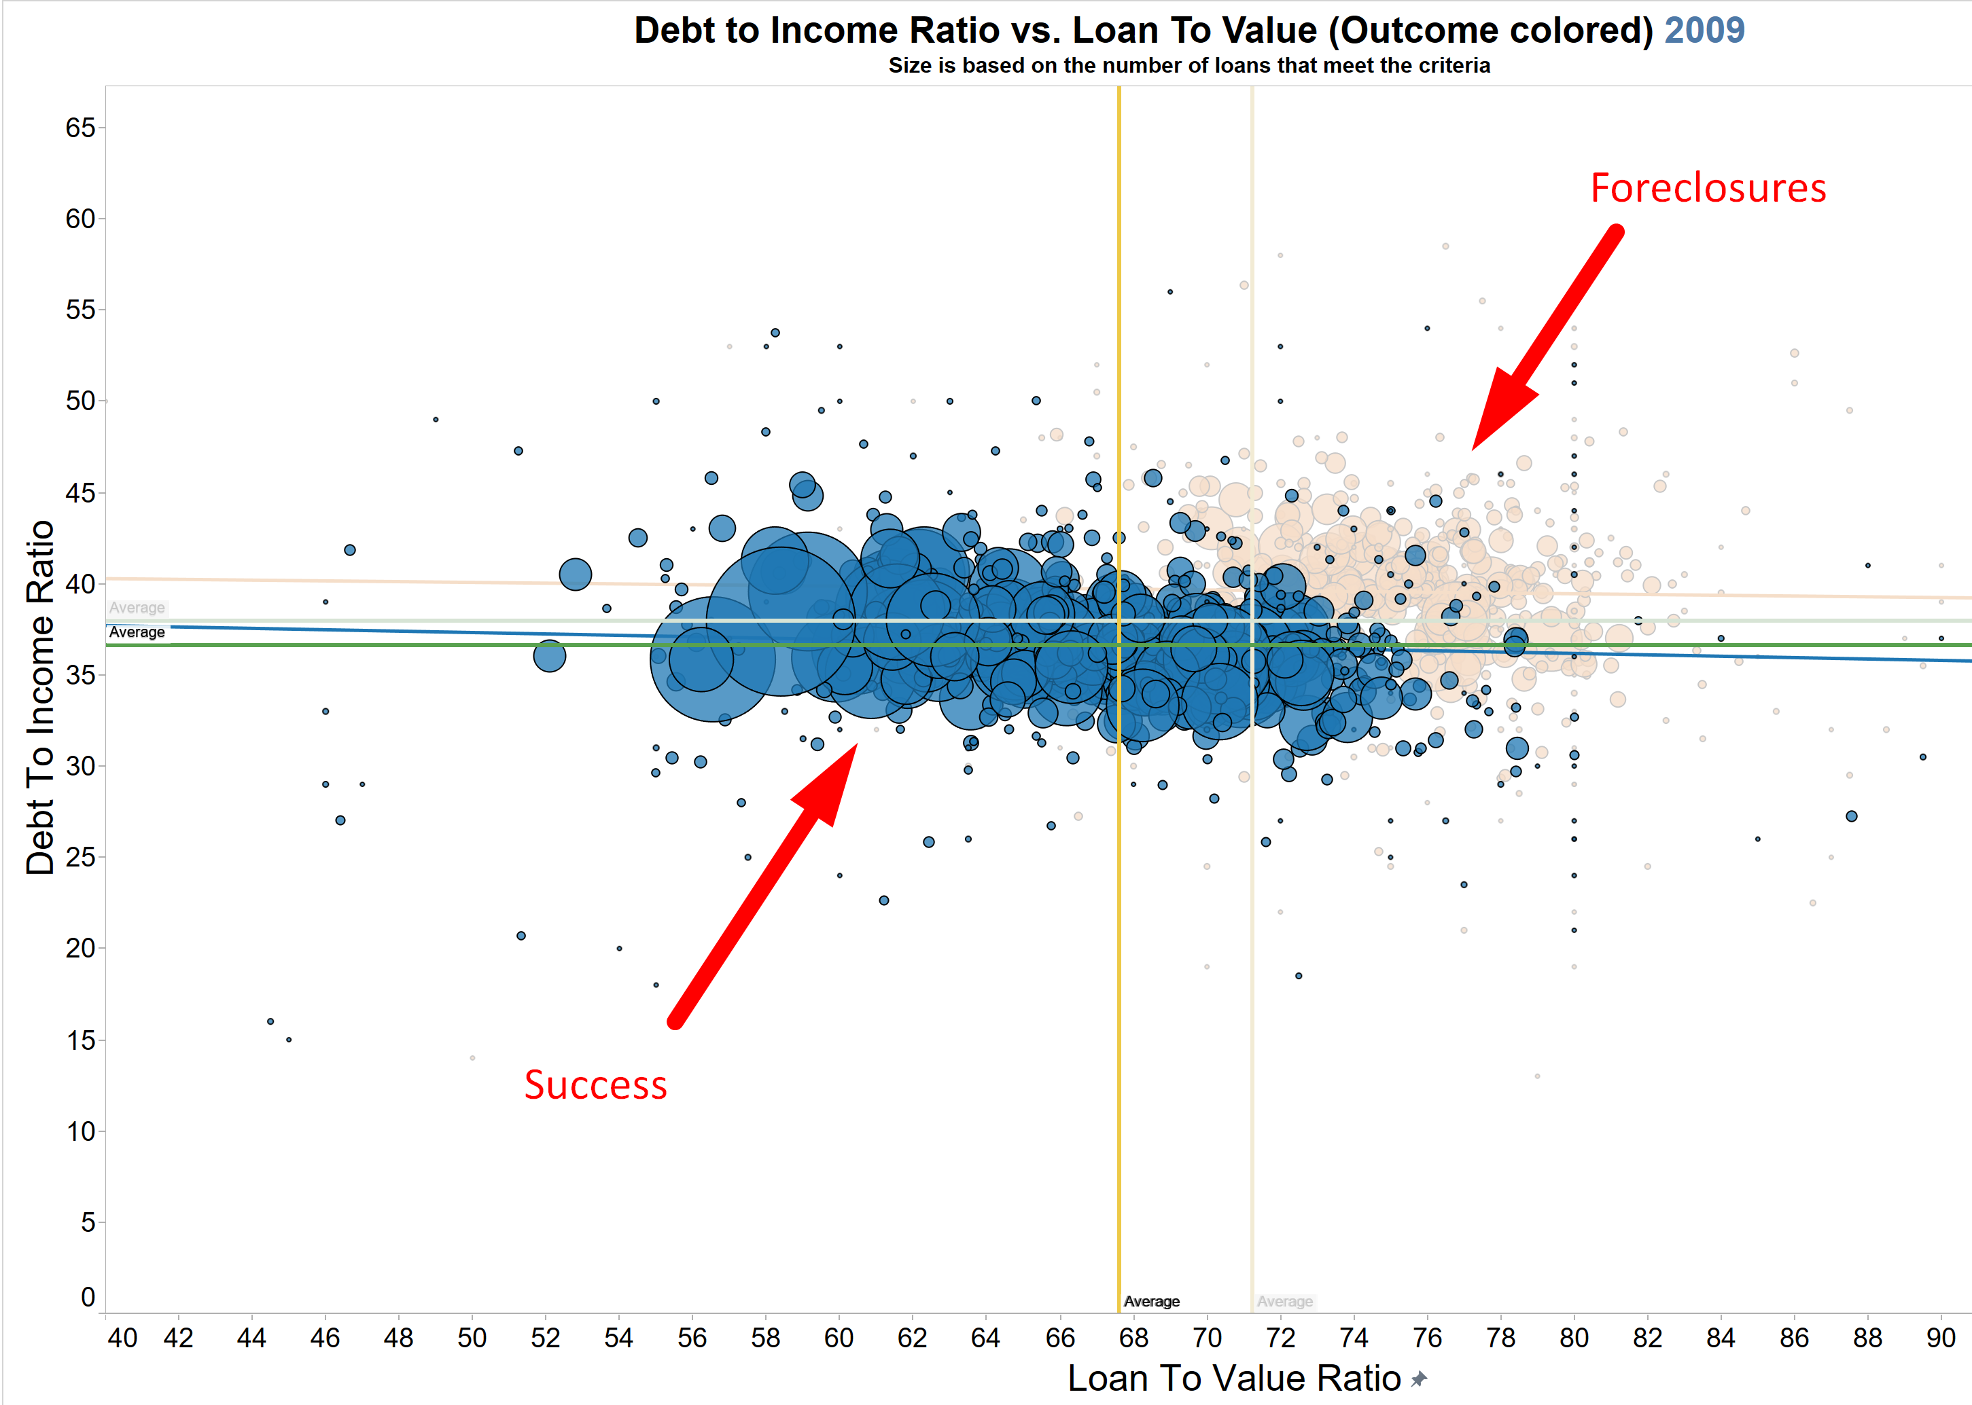
Can we Classify the Data?

Slide 13
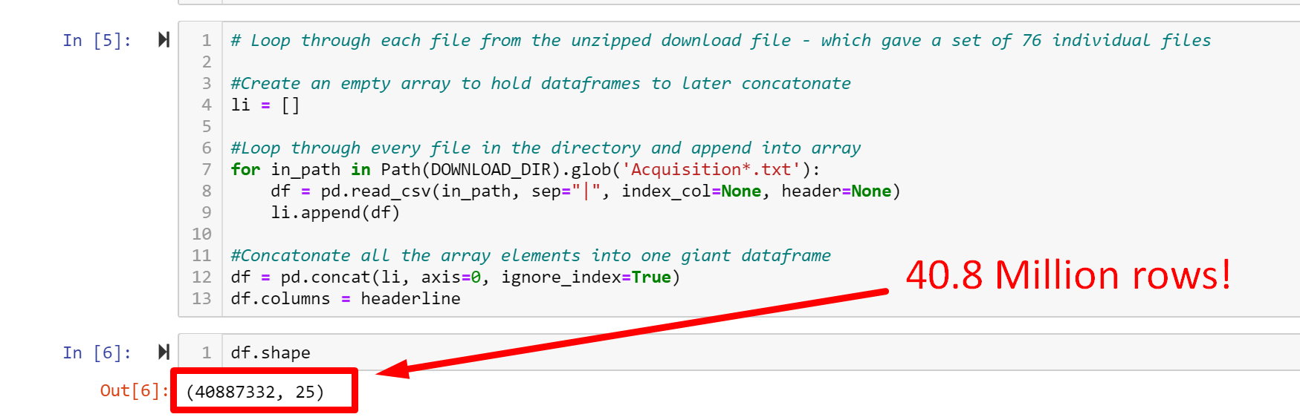
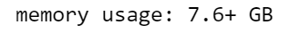
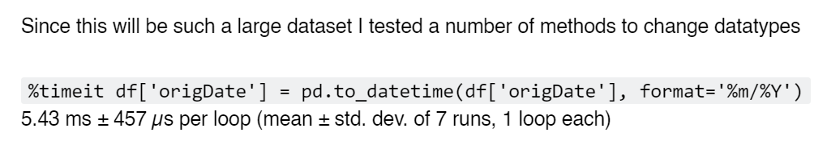
Loading the BIG Data

Slide 14


Productionalization of the Data
Raw Data Processing
Data Joining
Data Prep
EDA
EDA
ML
ML

Slide 15
Machine Learning
Justin boggs

Slide 16



ML Libraries Used

Slide 17
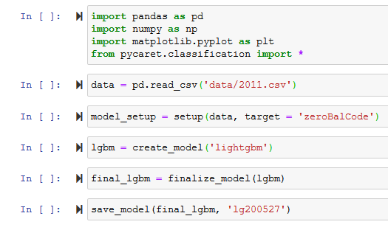
Why PyCaret?
Open-source
Low-code
It’s free!
Auto-ML

Slide 18
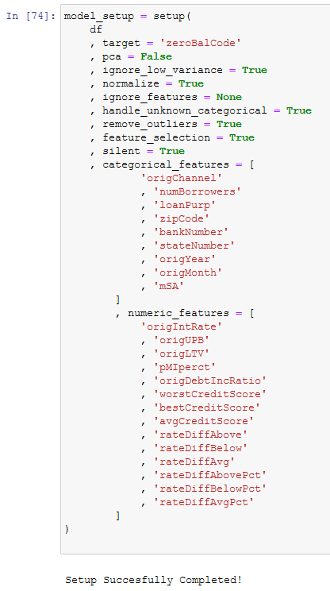
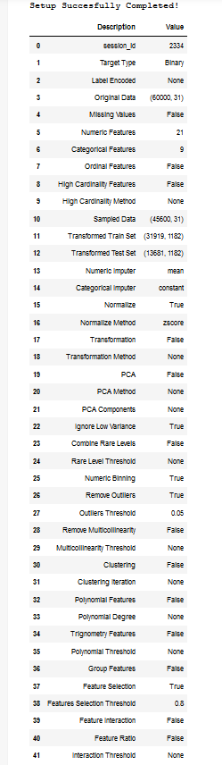
Model Setup
Scikit-learn
train/ test split
PyCaret
Supervised Learning
Classification module

Slide 19
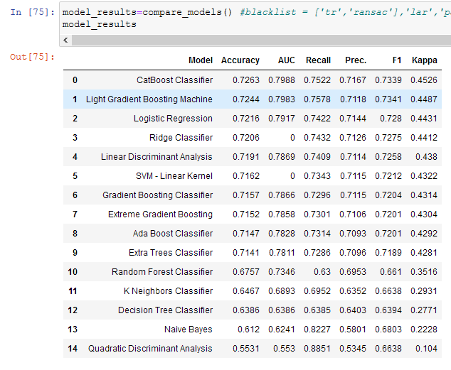
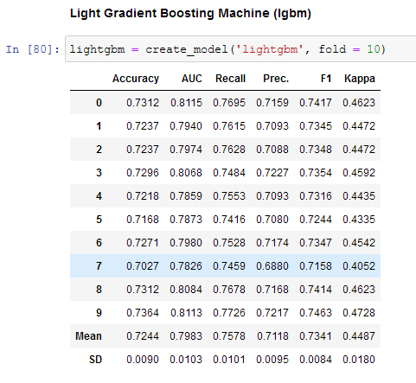
Model Output

Slide 20
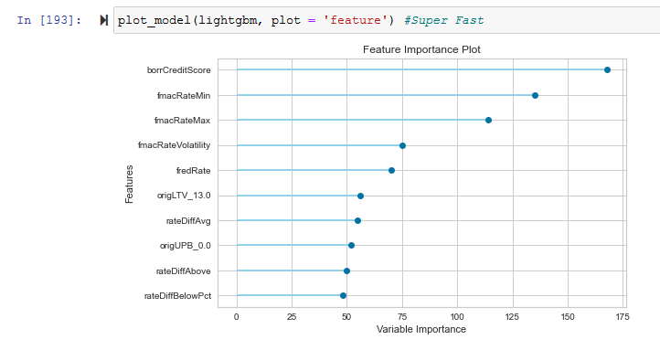
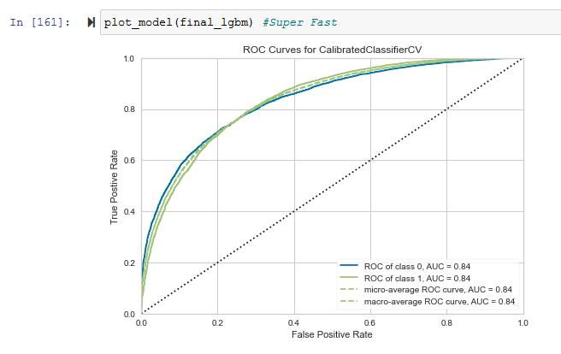
Plotting the Model

Slide 21
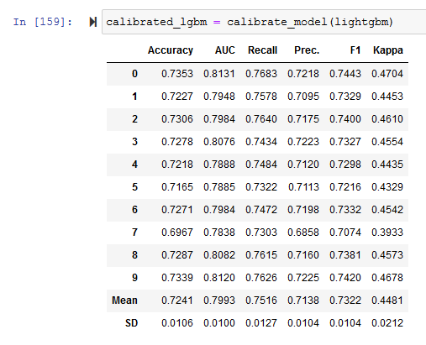
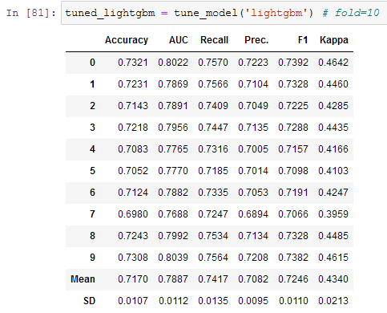
Other Options
Calibrated Model
Tuned Model

Slide 22
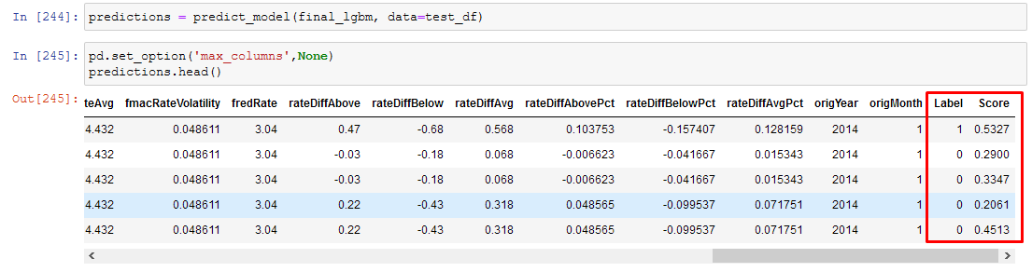
Predicting on New Data
Probability threshold

Slide 23
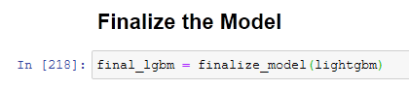
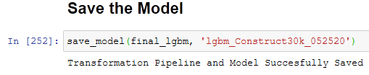
Finalizing and Saving the Model
.pkl file created.
Implemented in app

Slide 24
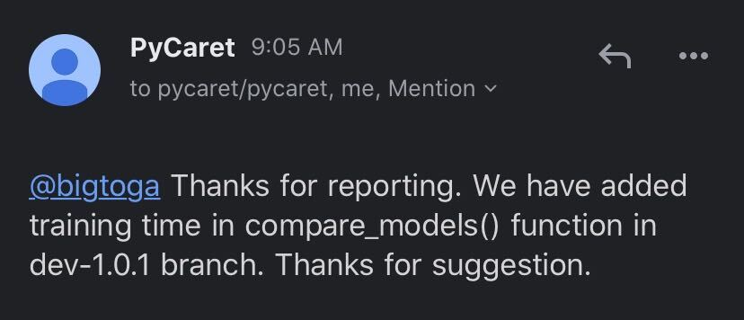
Improving PyCaret

Slide 25
Web Application and Front End
Sean del alcazar

Slide 26
Application Demo and Summary
Scott whigham

Slide 27
Thank you!

Slide 28
Supplemental Slides

Slide 29
Model Selection utilizing PyCaret – Our Dynamic Process
Initial comparison of all models
Check performance of all models
Select best model
Review Feature Importance
Data Pre-processing
Check performance of all models
Define Train / Testing Split Define sampling and oversampling methodology Return to this step if no models meet threshold
Provides initial accuracy statistics of multiple Classification models EMPHASIS: runtime DECISION POINT: runtimes for each model will vary, and if runtime is too long then that model gets eliminate
Provides enhanced analysis of model performance: i.e. Confusion matrix EMPHASIS: runtime DECISION POINT: runtimes for each will vary, if too long then not practical for further analysis, that model gets eliminated
We can further enhance our model by identifying most appropriate input variables EMPHASIS: identifying additional model adjustments DECISION POINT: if feature importance analysis determines other input variables may enhance model, return to model setup stage
Further analysis is now available on limited models with realistic runtimes, and appropriate input variables. Return to Data Pre-processing to adjust train/test split, and (over)sampling methodology if accuracy does not meet threshold EMPHASIS: accuracy DECISION POINT: after enhanced analysis, compare accuracy metrics with confusion matrix
File size will impact deployment runtimes, so at this stage we can save our final models and compare the file size. EMPHASIS: accuracy, size DECISION POINT: Select model with best mix of accuracy, speed (runtime), and size
Return to previous stages as determined by Decision Points

Slide 30
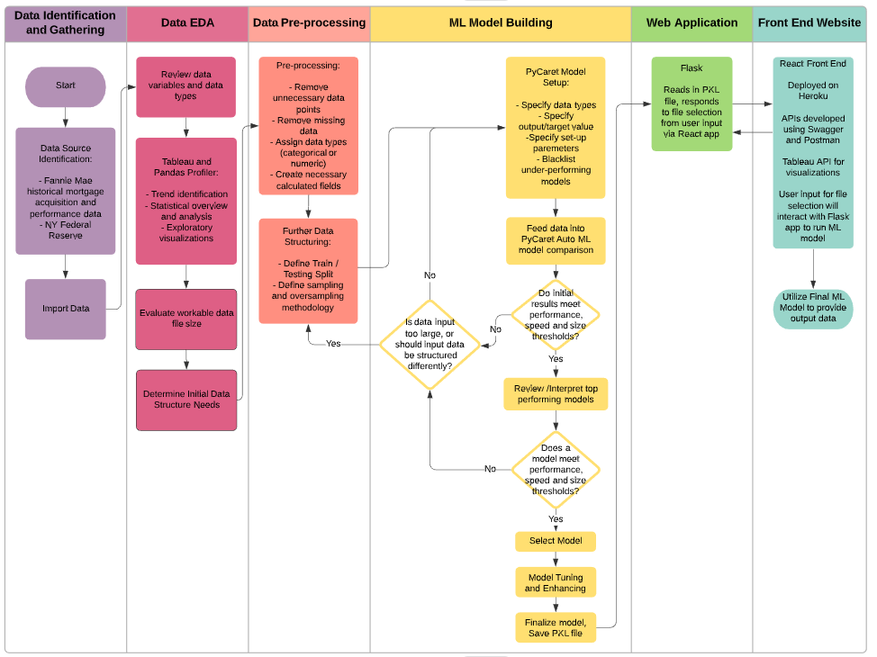
Project and Application Workflow

